Slide 1
Introduction to Queue Data Structure
Prepared by
Lec Shekh. Md. Saifur Rahman
PREPARED BY
SWAPNIL BISWAS

Slide 2





Introduction to Queue Data Structure
At present people rely on messaging application like WhatsApp, Facebook, Messenger, Instagram chat to communicate with friends and family

Slide 3
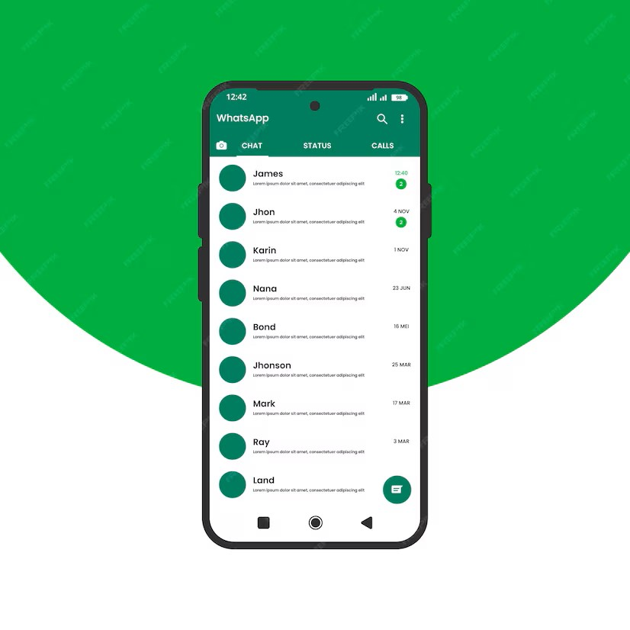
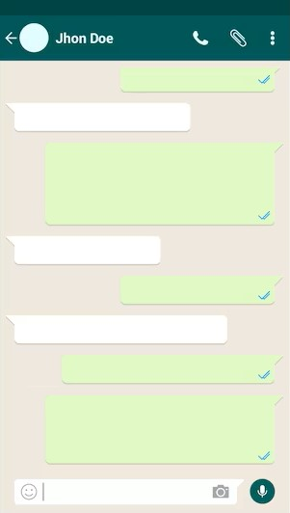
Introduction to Queue Data Structure
In these messaging applications, the order of message is maintained for each user.

Slide 4

Introduction to Queue Data Structure
Queues are maintained for each user containing messages to be delivered…
Once user connects to the network messages in the queue get delivered.
How are these applications maintaining the order of text messages?

Slide 5
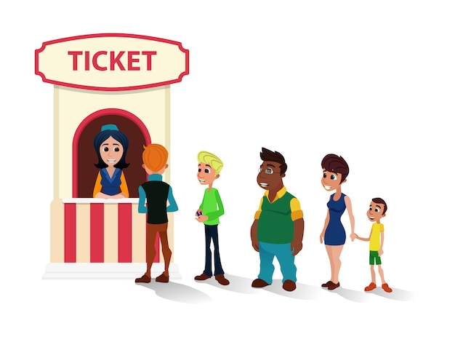
Structure of Queue
Let’s take an example of a movie ticket counter to understand the structure of queue…
Both the ends are fixed!
Open at both ends

Slide 6
Structure of Queue
Let’s take an example of a movie ticket counter to understand the structure of queue…
A queue is a linear data structure that follows the First-In-First-Out (FIFO) principle
Person who enters first receives the movie ticket first
Person who enters last will receive the ticket last

Slide 7
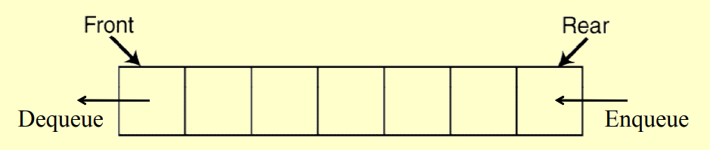
Structure of Queue
The queue is a linear collection of different data types
Both the ends of queue data structure are open allowing it to have different operations at different ends
The end at which insertion takes place is called REAR.
The end at which deletion takes place is known as FRONT.

Slide 8
Queue Operations
Supported operations are:
enqueue(argument)
dequeue( )
peek( )
isEmpty( )
isFull( )
clear( )

Slide 9
Variation of Queue
Linear Queue
Circular Queue (also known as Ring Buffer)
Priority Queue
Double Ended Queue (also known as DEQUE)

Slide 10
Implementation of Queue
Using Array
Using Linked List

Slide 11
Array Implementation(Linear Queue)
Suppose we have an empty static queue that holding a maximum of three values.
At first, when array is empty, front = -1, back = -1.
Lets do some enqueue operations…
Lets do some dequeue operations…
Lets code it.
Time Complexity Analysis
0
1
2

Slide 12
Array Implementation(Linear Queue) - Limitations
0 | 1 | 2 | 3 | 4
front = -1, rear = -1
Wasting Memory

Slide 13
Array Implementation(Linear Queue) - Limitations
enqueue(4)
0 | 1 | 2 | 3 | 4
4
front
rear

Slide 14
Array Implementation(Linear Queue) - Limitations
enqueue(9)
0 | 1 | 2 | 3 | 4
4 | 9
front
rear

Slide 15
Array Implementation(Linear Queue) - Limitations
enqueue(5)
0 | 1 | 2 | 3 | 4
4 | 9 | 5
front
rear

Slide 16
Array Implementation(Linear Queue) - Limitations
enqueue(3)
0 | 1 | 2 | 3 | 4
4 | 9 | 5 | 3
front
rear

Slide 17
Array Implementation(Linear Queue) - Limitations
enqueue(3)
0 | 1 | 2 | 3 | 4
4 | 9 | 5 | 3 | 3
front
rear

Slide 18
Array Implementation(Linear Queue) - Limitations
enqueue(2)
0 | 1 | 2 | 3 | 4
4 | 9 | 5 | 3 | 3
front
rear
Overflow

Slide 19
Array Implementation(Linear Queue) - Limitations
dequeue()
0 | 1 | 2 | 3 | 4
 | 9 | 5 | 3 | 3
front
rear

Slide 20
Array Implementation(Linear Queue) - Limitations
dequeue()
0 | 1 | 2 | 3 | 4
 |  | 5 | 3 | 3
front
rear

Slide 21
Array Implementation(Linear Queue) - Limitations
enqueue(4)
0 | 1 | 2 | 3 | 4
 |  | 5 | 3 | 3
front
rear
Overflow although queue is not full

Slide 22
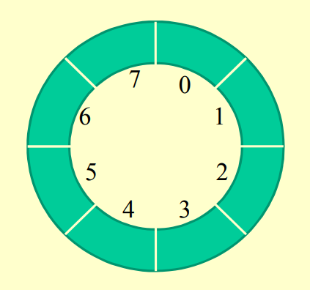
Array Implementation(Circular Queue)
front = -1, rear = -1

Slide 23
Array Implementation(Circular Queue)
enqueue(1)
front
1
rear
front = 0
rear = 0
Queue[rear] = 1

Slide 24
Array Implementation(Circular Queue)
enqueue(5)
front
1
5
rear
front = 0
rear = (rear+1)%8
Queue[rear] = 1

Slide 25
Array Implementation(Circular Queue)
enqueue(10)
front
1
rear
front = 0
rear = (rear+1)%8
Queue[rear] = 1
10
5
3
1
23
4

Slide 26
Array Implementation(Circular Queue)
enqueue(5)
front
rear
5
1
10
5
front = 0
rear = (rear+1)%8
Queue[rear] = 1
3
1
23
4

Slide 27
Array Implementation(Circular Queue)
enqueue(6)
front
rear
front = 0
rear = (rear+1)%8
= 0
If(front == rear)
overflow
else
Queue[rear] = 6
5
1
10
5
3
1
23
4
Overflow

Slide 28
Array Implementation(Circular Queue)
dequeue()
rear
front = (front+1)%8
= 0
rear = 7
5
front
10
5
3
1
23
4

Slide 29
Array Implementation(Circular Queue)
dequeue()
rear
front = (front+1)%8
=1
rear = 7
5
10
3
1
front
23
4

Slide 30
Linked List Implementation(Linear Queue)
Suppose we have an empty dynamic queue implemented using Singly Linked List. And the structure of each of these node is defined using this definition:
struct Node {
int val;
Node *next;
}
At first, when the queue is empty, Node *front = NULL, *rear = NULL
Lets do some enqueue operations…
Lets do some dequeue operations…
Lets code it.
Time Complexity Analysis
val | next
an example node

Slide 31
Priority Queue
A priority queue is a type of queue in which each element is assigned a priority
The elements are inserted at the rear
The elements are deleted according to the priority
Each operation in a priority queue takes logarithmic time (log-n)
Priority queues can be implemented using a heap data structure, which will be covered in DSA-II.

Slide 32
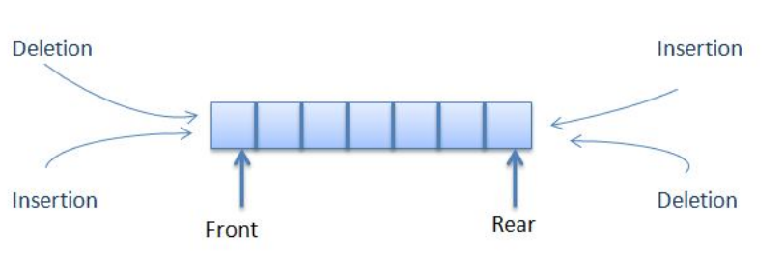
Double Ended Queue
Deque (short form of Double-Ended QUEue) is a linear list in which elements can be inserted or deleted at either end but not in the middle.
Pronounced as “DECK”.
That is, elements can be inserted/deleted to/from the rear or the front end.

Slide 33
Double Ended Queue
Possible Operation:
insertFront( )
insertRear( )
deleteFront( )
deleteRear( )
isEmpty( )
isFull( )
front( )
rear( )
clear( )

Slide 34
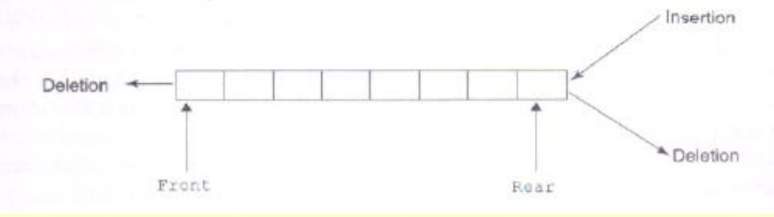
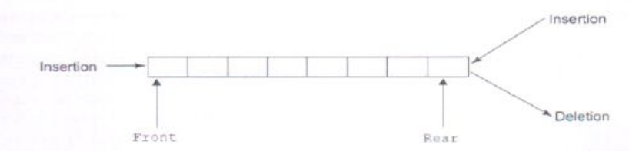
Variations of DEQUE
Input restricted deque: It allows insertion of elements at one end only but deletion can be done at both ends.
Output restricted deque: It allows deletion of elements at one end only but insertion can be done at both ends.

Slide 35
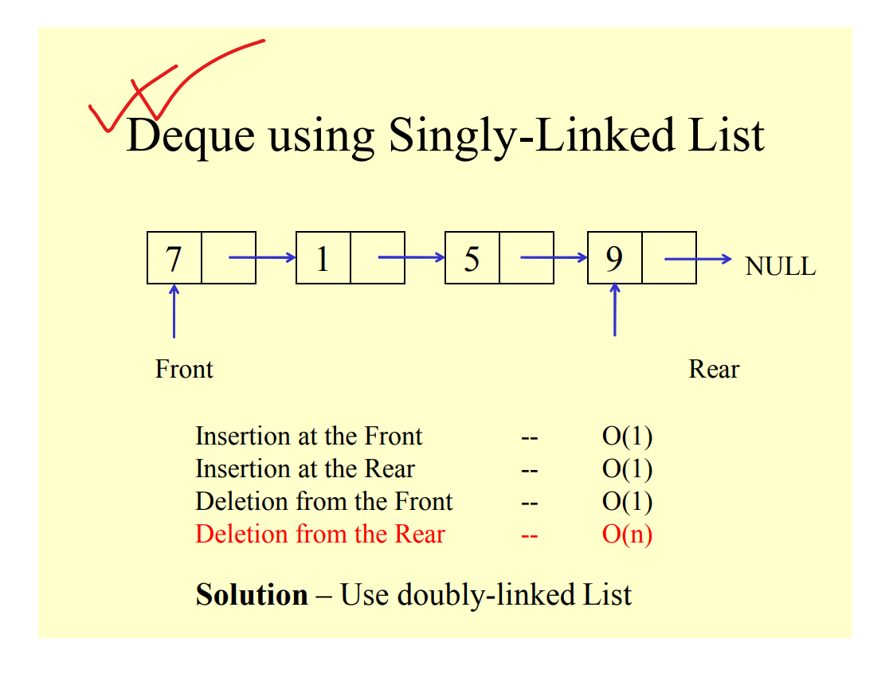
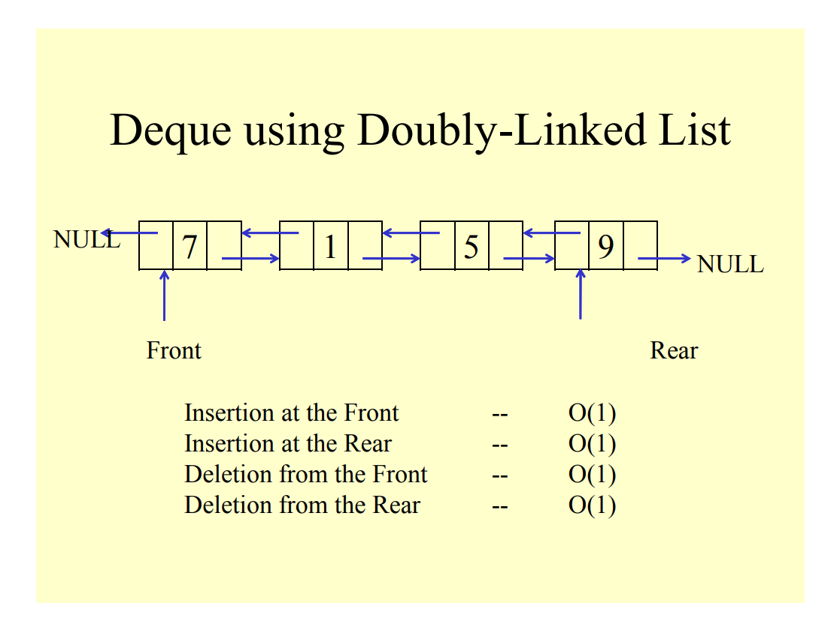
Complexity Analysis of DEQUE

